Slide 1
Employee Data Analysis using Excel
STUDENT NAME: CHARUMATHI. R
REGISTER NO: asunm1659312216763
DEPARTMENT: B.COM (ACCOUNTING &FINANCE)
COLLEGE: SHRI KRISHNASWAMY COLLEGE FOR WOMEN

Slide 2
PROJECT TITLE
Employee Performance Analysis using Excel

Slide 3


AGENDA
Problem Statement
Project Overview
End Users
Our Solution and Proposition
Dataset Description
Modelling Approach
Results and Discussion
Conclusion
3/21/2024 Annual Review

Slide 4

PROBLEM STATEMENT
Objective: To analyse and evaluate employee performance using data recorded in an Excel spreadsheet. The goal is to identify patterns, assess performance metrics, and provide actionable insights to improve overall productivity and employee satisfaction.
Assess Individual Performance: Evaluate how well each employee is performing against set targets and goals.
Identify High and Low Performers: Pinpoint employees who consistently perform at a high level and those who may need additional support or training.
Determine Trends and Patterns: Recognize any trends or patterns in performance over time or across different departments .
Provide Recommendations: Offer actionable recommendations based on the analysis to help improve employee performance and overall team effectiveness.

Slide 5

PROJECT OVERVIEW
.
Objective : To utilize Excel for a comprehensive analysis of employee performance metrics, providing insights into individual and team performance, identifying areas for improvement, and supporting data-driven decision-making to enhance overall productivity and job satisfaction.
Scope: This project involves analysing employee performance data, including sales figures, project completion rates, customer feedback, and attendance records, over a specified period. The analysis will result in actionable insights and recommendations for performance management and employee development.

Slide 6

WHO ARE THE END USERS?
Human Resources (HR) Department Role: HR professionals use performance analysis to make decisions about employee development, training needs, promotions, and terminations.
2. Management Team Role: Managers and executives use performance data to make strategic decisions about resource allocation, team composition, and overall business strategy.
3. Team Leaders/Supervisors Role: Direct supervisors and team leaders use performance data to provide feedback, set goals, and monitor the progress of their team members
4. Employees Role: Employees may be the indirect users of performance analysis through feedback and performance reviews.
5.Training and Development Teams Role: Professionals responsible for employee training and development use performance data to design and implement targeted training programs.

Slide 7

OUR SOLUTION AND ITS VALUE PROPOSITION
Our solution leverages Excel to perform a comprehensive analysis of employee performance data.
By organizing, analyzing, and visualizing performance metrics, we provide actionable insights that help organizations manage and enhance employee performance effectively.
Features:
1.Data Organization and Cleaning:
Structured DataManagement
Error Detection
2.Performance Metrics Analysis:
Aggregated Metrics
Benchmarking targets
3.Trend and Pattern Analysis:
Time-Series Analysis
Cross-Departmental Insights

Slide 8
Dataset Description
Dataset Structure : File Format: Excel (.xlsx or .xls)Sheet Structure: Typically organized into multiple sheets or tables, each representing different aspects of employee performance
Sheets/ Tables:
Sheet 1: Employee Information
Purpose: Contains basic details about each employee for identification and categorization.
Columns:-
Employee ID: Unique identifier for each employee.
First Name: Employee's first name
Last Name: Employee's last name
Department: Department where the employee works (e.g., Sales, Marketing, HR)
Job Title: Employee’s position or role
Hire Date: Date the employee was hired
Manager ID: ID of the employee’s direct manager

Slide 9
Sheet 2:
Performance Metrics Purpose: Contains quantitative metrics used to evaluate employee performance
Columns:
Employee ID: Unique identifier for linking with Employee Information .
Review Period: Time period for the performance review (e.g., Q1 2024, FY 2024).Sales Figures: Total sales or revenue generated by the employee (if applicable).
Projects Completed: Number of projects or tasks completed by the employee.
Customer Feedback Score: Average score from customer feedback or satisfaction surveys.
Attendance: Number of days present versus absent.
Targets Achieved: Percentage or count of targets or goals achieved by the employee.
Sheet 3:
Attendance RecordsPurpose: Tracks attendance-related data for performance analysis.
Columns:
Employee ID: Unique identifier for linking with Employee Information .
Date: Specific date of attendance or absence .
Status: Attendance status (e.g., Present, Absent, Sick Leave, Vacation).
Hours Worked: Number of hours worked on each date.
Reason for Absence: If applicable, the reason for absence (e.g., Sick, Personal).

Slide 10
Sheet 4:
Training and Development Purpose: Records details about training and development activities.
Columns:
Employee ID: Unique identifier for linking with Employee Information.
Training Program: Name of the training or development program attended.
Completion Date: Date when the training was completed.
Certification Awarded: Any certifications or qualifications earned.
Training Hours: Total number of hours spent in training.
Sheet 5:
Goals and Objectives Purpose: Tracks individual and departmental goals and objectives
Columns:
Employee ID: Unique identifier for linking with Employee Information.
Goal Description: Description of the goal or objective set.
Target Date: Deadline for achieving the goal.
Status: Current status of the goal (e.g., Not Started, In Progress, Completed).Achievement Level: Percentage of the goal achieved or notes on performance against the goal.

Slide 11

THE "WOW" IN OUR SOLUTION
Advanced Data Visualization : Interactive Dashboards: Create dynamic dashboards that offer real-time insights into employee performance. Use interactive elements like slicers and drop-down menus to allow users to filter and view data by different parameters (e.g., department, time period).Custom Charts and Graphs: Incorporate visually appealing and easy-to-understand charts, such as heat maps, sparklines, and trend lines, to highlight key performance indicators and trends.
Automated Data Analysis :Automated Calculations: Use advanced Excel formulas and functions (e.g., INDEX-MATCH, SUMIFS, AVERAGEIFS) to automate complex calculations and aggregations, saving time and reducing the risk of errors. Conditional Formatting: Apply conditional formatting to instantly highlight significant performance deviations, such as high achievers or underperformers, using color codes and data bars.
3/21/2024 Annual Review
11

Slide 12
Comprehensive Performance Metrics:360-Degree Performance Overview: Integrate various performance metrics—sales figures, project completion rates, customer feedback, attendance records, and training achievements—into a single comprehensive analysis.Benchmarking and Goal Tracking: Compare individual performance against benchmarks and goals to measure achievements and identify gaps, helping to set realistic targets and expectations.
4. Insightful Trend Analysis:Historical Performance Trends: Track and analyze performance trends over multiple periods to identify patterns, seasonality, and long-term changes.Predictive Analytics: Use historical data to forecast future performance trends and potential outcomes, aiding in strategic planning and resource allocation.
5. Actionable Insights and Recommendations:Data-Driven Recommendations: Generate actionable recommendations based on performance analysis, such as tailored development programs, targeted interventions, and strategic adjustments.Highlighting Success Stories: Identify and showcase high performers and success stories to motivate employees and recognize their contributions.
3/21/2024 Annual Review
12

Slide 13
MODELLING
Excel modelling for employee performance analysis involves creating structured and dynamic models that allow you to evaluate, interpret, and visualize employee performance data effectively. Here’s a comprehensive guide on how to set up and use such a model:
Data Collection and Preparation
Define Objectives : Determine what aspects of performance you need to analyze (e.g., productivity, attendance, sales, feedback).
Gather Data : Collect relevant data from various sources such as HR systems, project management tools, and feedback surveys.
Clean and Structure Data : Ensure that data is accurate, complete, and formatted consistently.
Organize data into structured sheets or tables in Excel.
2. Building the Excel Model
a. Data Sheets Setup :
Employee Information Sheet
Performance Metrics Sheet
Attendance Records Sheet
Training and Development Sheet
Goals and Objectives Sheet
13

Slide 14
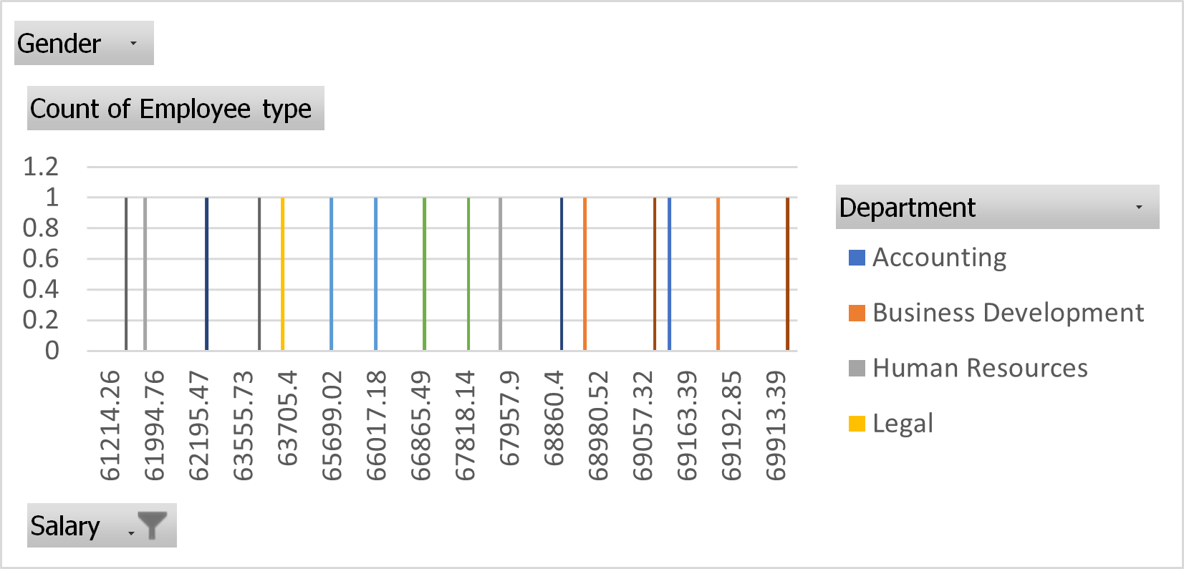
RESULTS
14

Slide 15
conclusion
Employee performance analysis is crucial for optimizing organizational efficiency, identifying top talent, and addressing areas for improvement. Utilizing Excel for this analysis offers a versatile, cost-effective approach that empowers organizations to gain actionable insights into their workforce.
THANK YOU

